Slide 1

Unlocking Insights into the Global Air Transportation Network
NM ID = FFB433FA0E985C29C9E494565FEF2402

Slide 2
My Team Members
Nagarathinam
Naveen
Sangesh waran
Santhosh

Slide 3
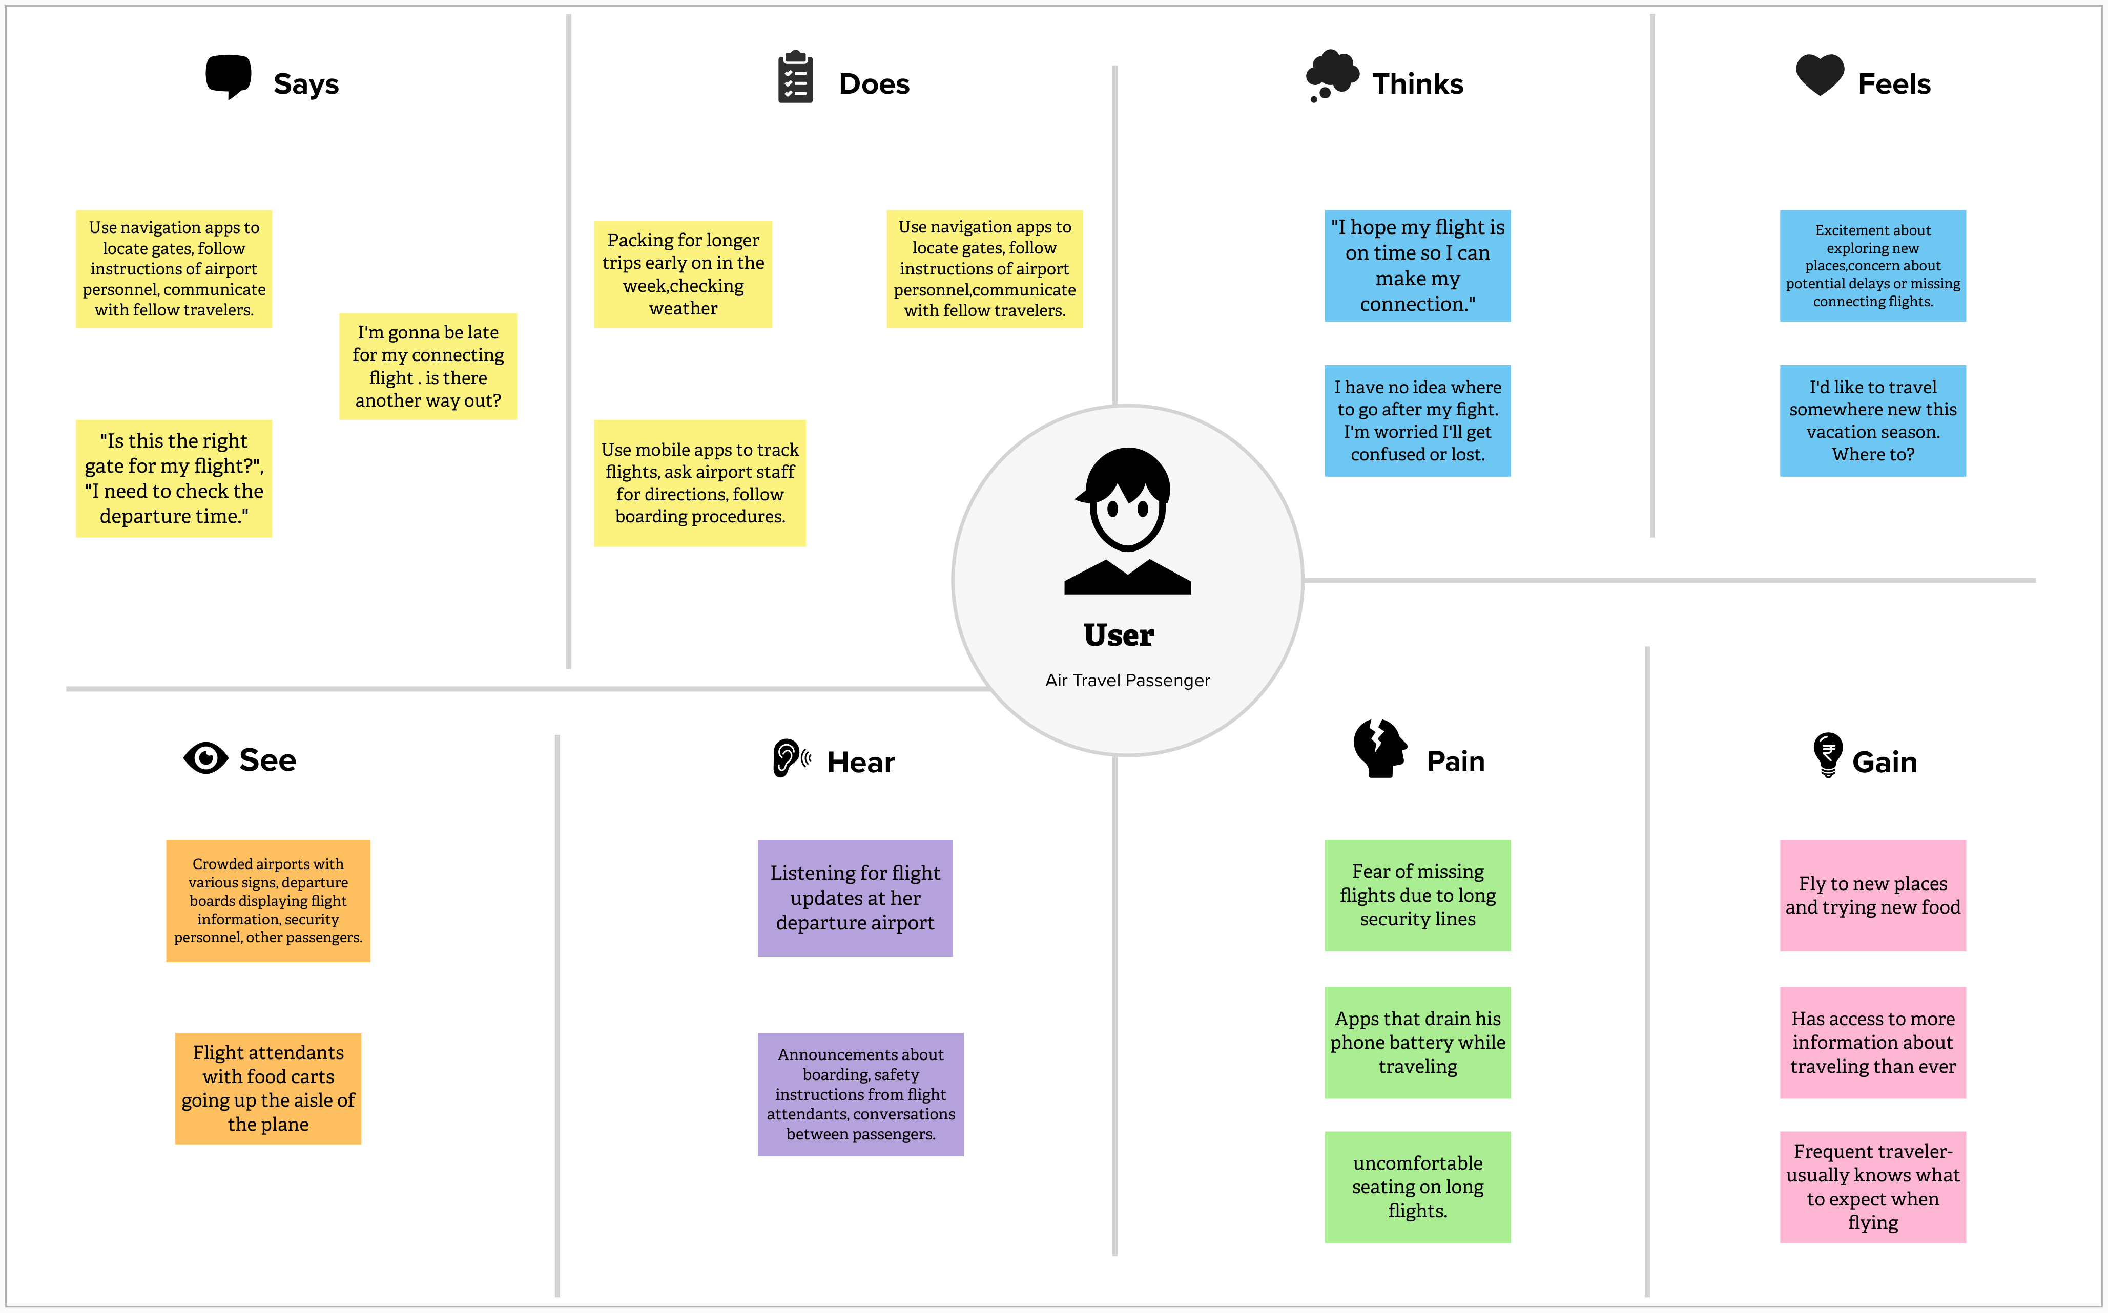

Slide 4
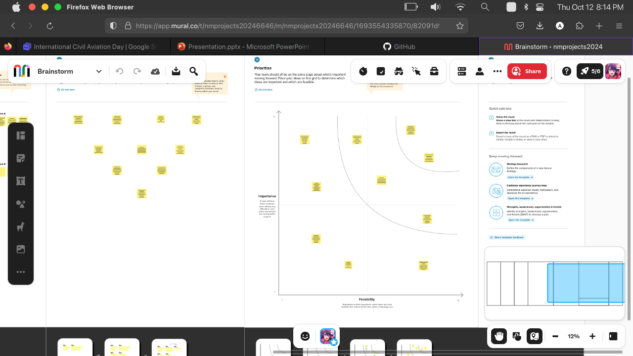

Slide 5
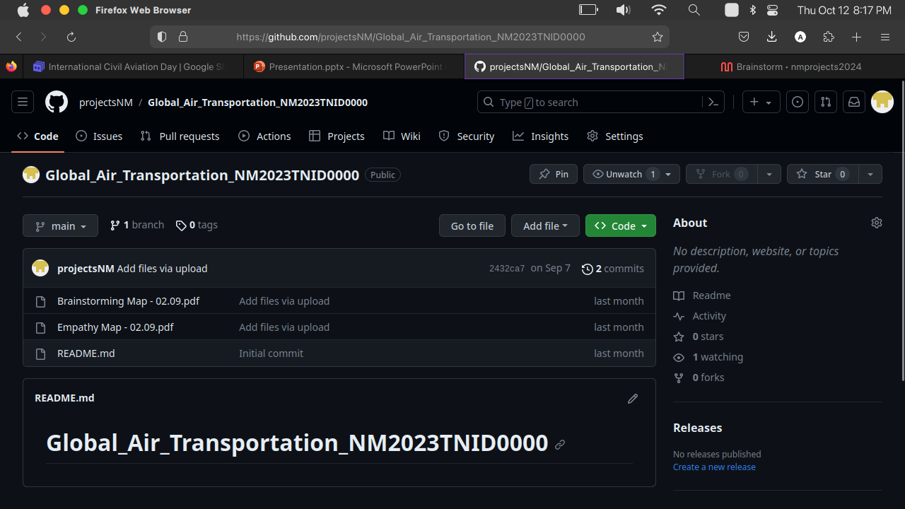

Slide 6
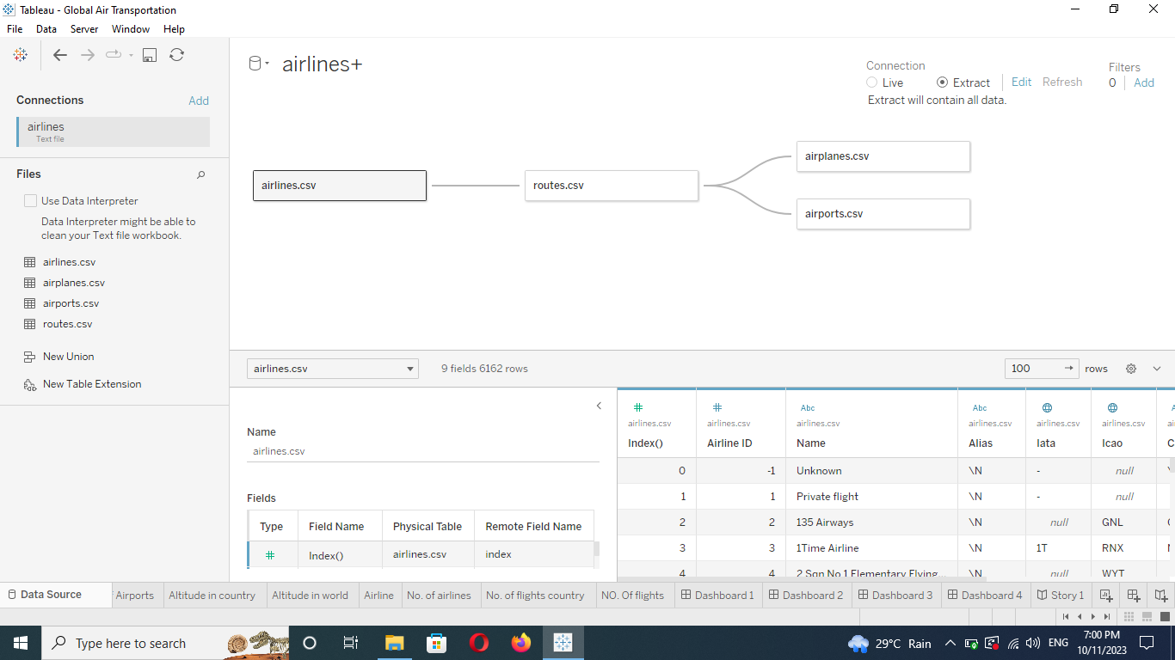
DATA SOURCE

Slide 7
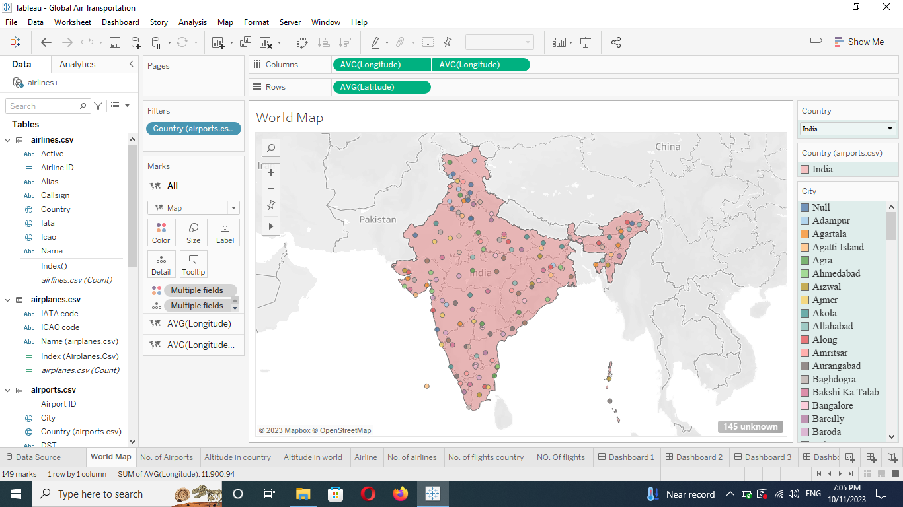
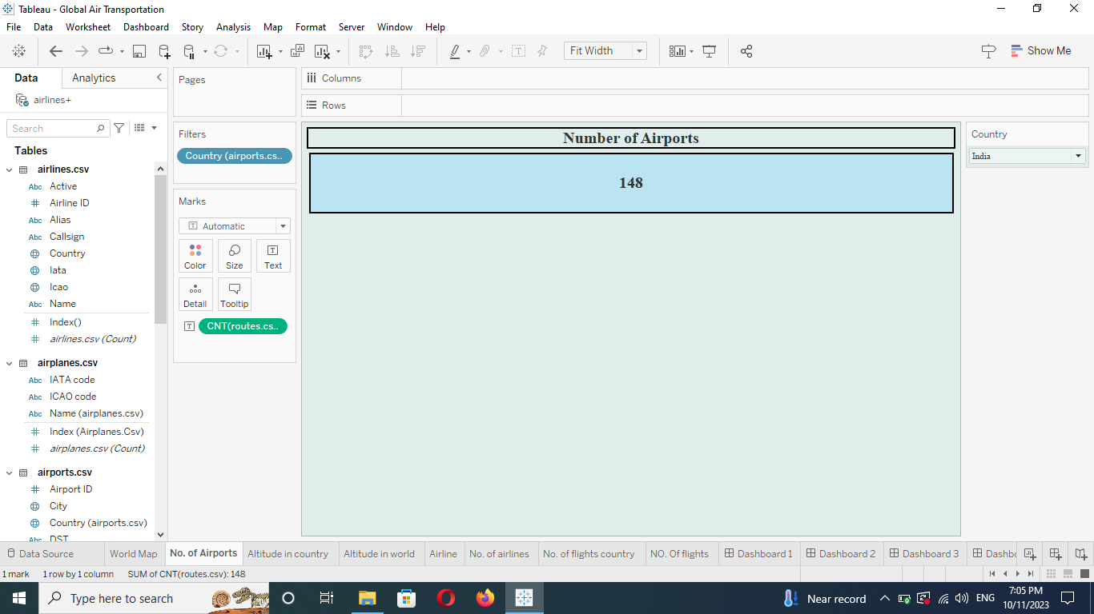
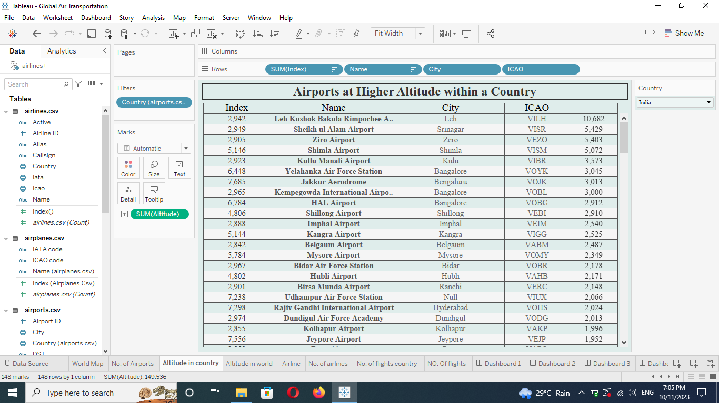
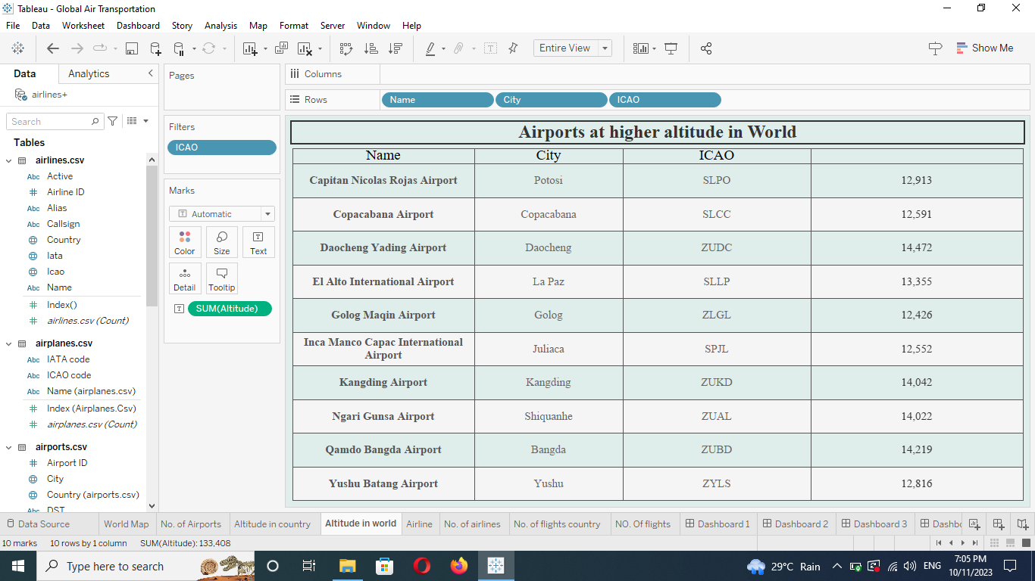
GLOBAL AIR TRANSPORTATION NETWORK
1_World map
2_No of Airports
3_Altitude in country
4_Altitude in World

Slide 8
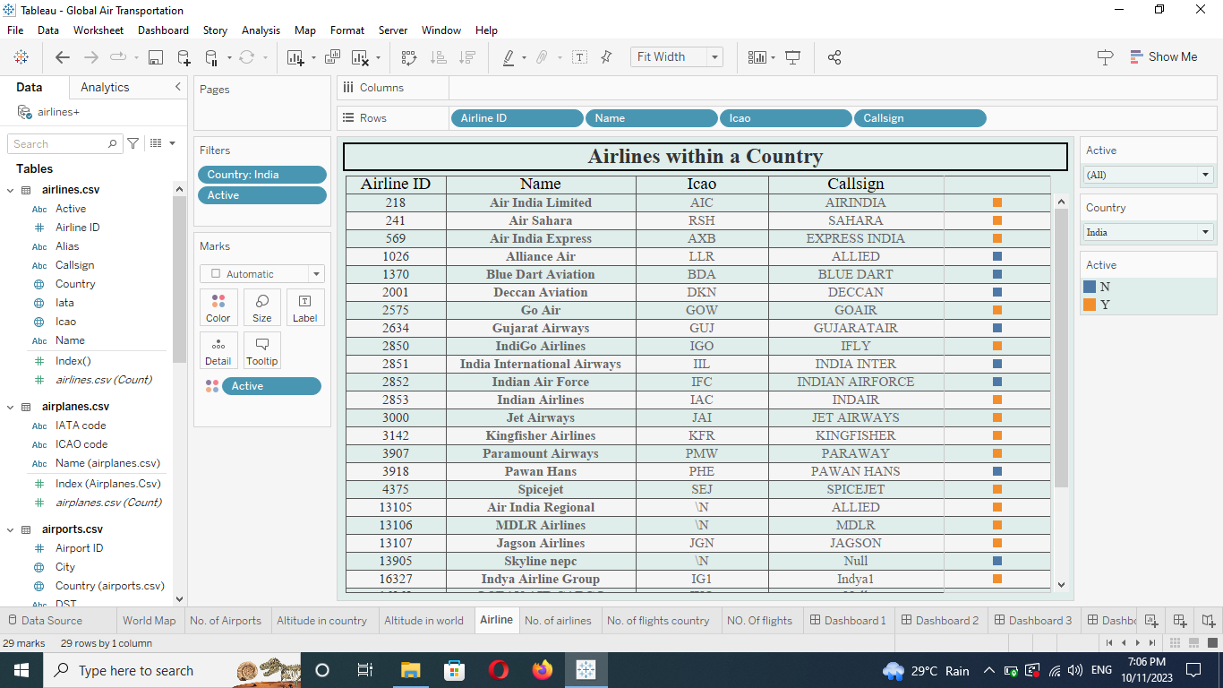
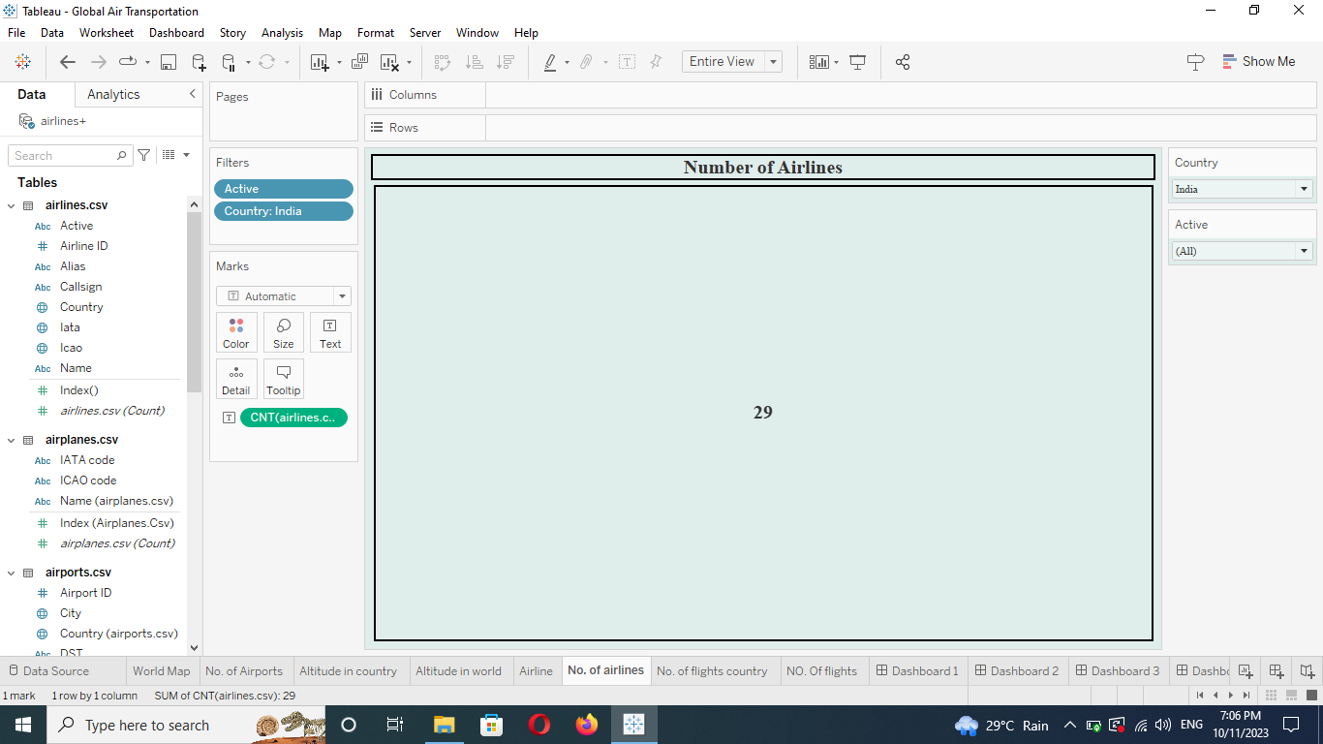
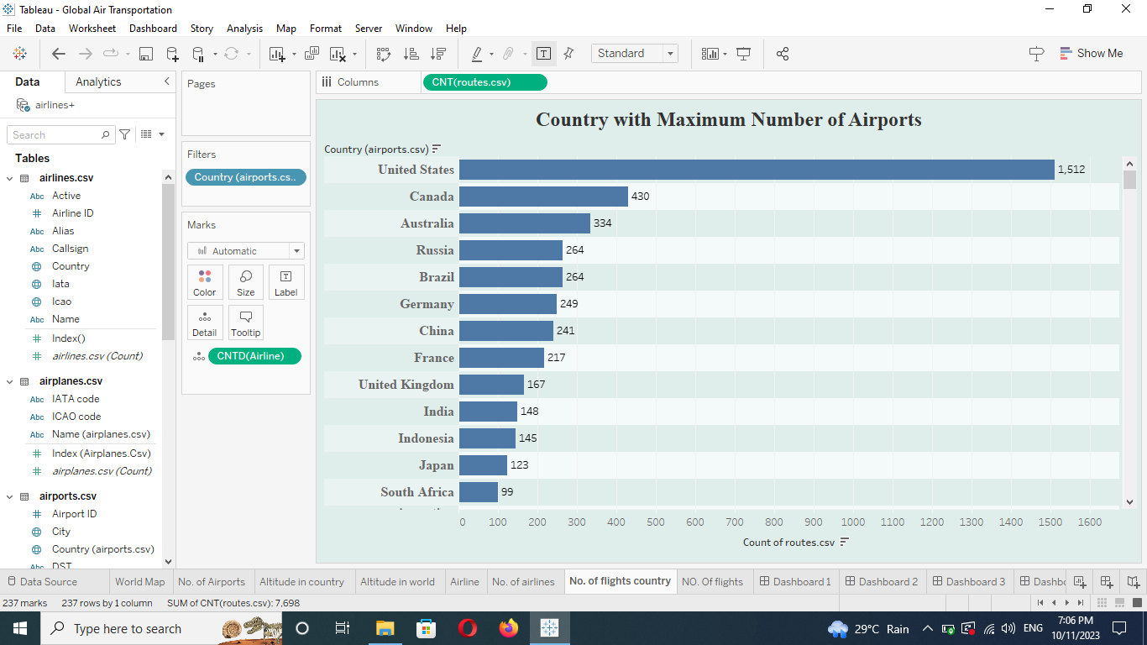
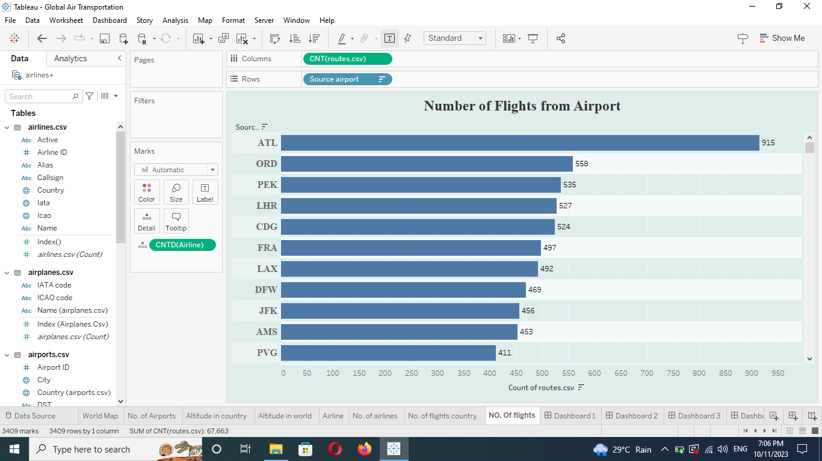
GLOBAL AIR TRANSPORTATION NETWORK
5_Airline
6_No of Airlines
7_No of flight in country
8_N0 of flights

Slide 9
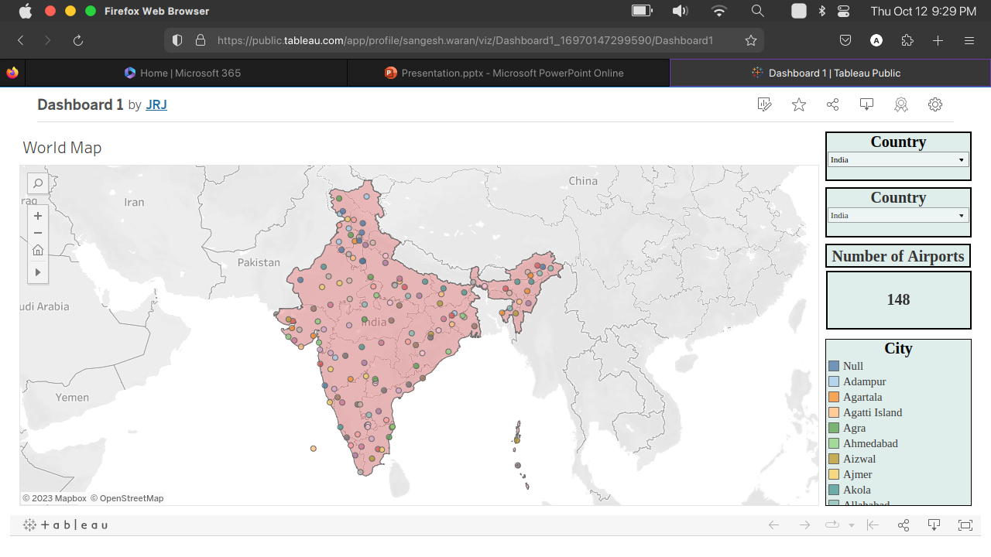
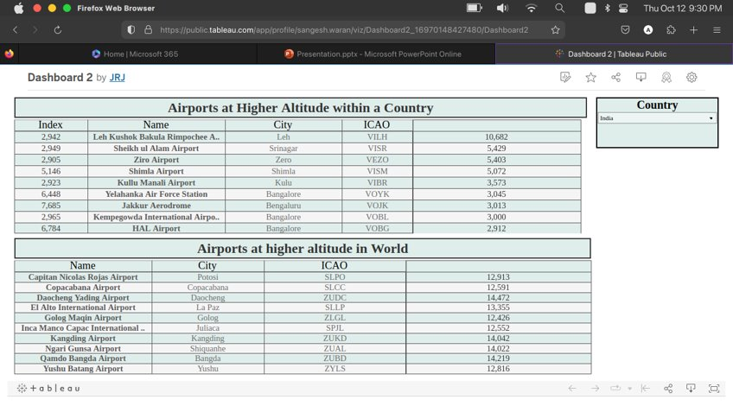
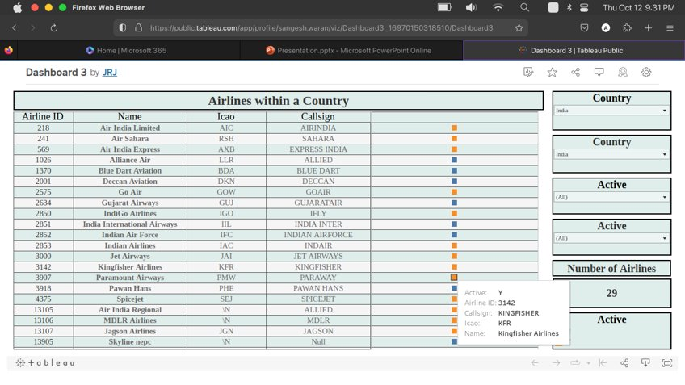
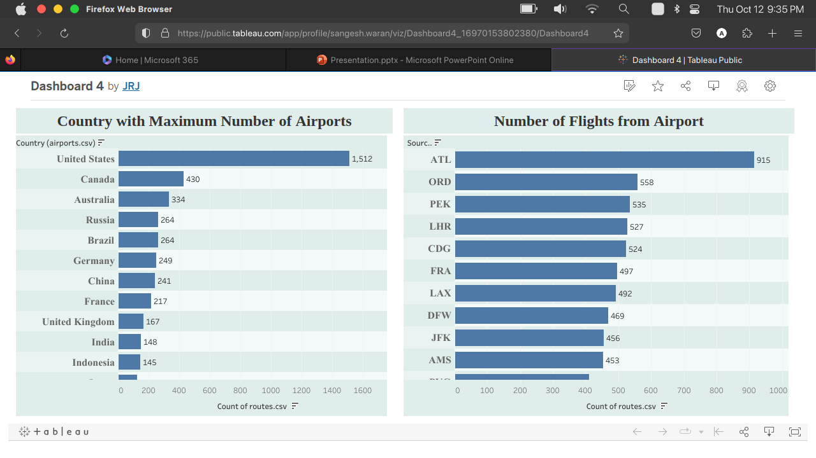
DASHBOARD

Slide 10
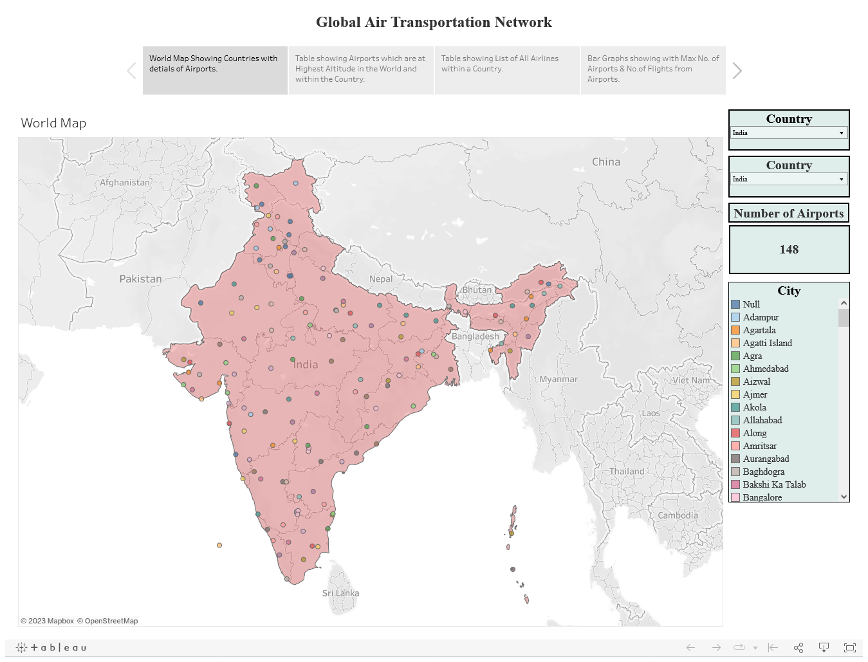

Slide 11
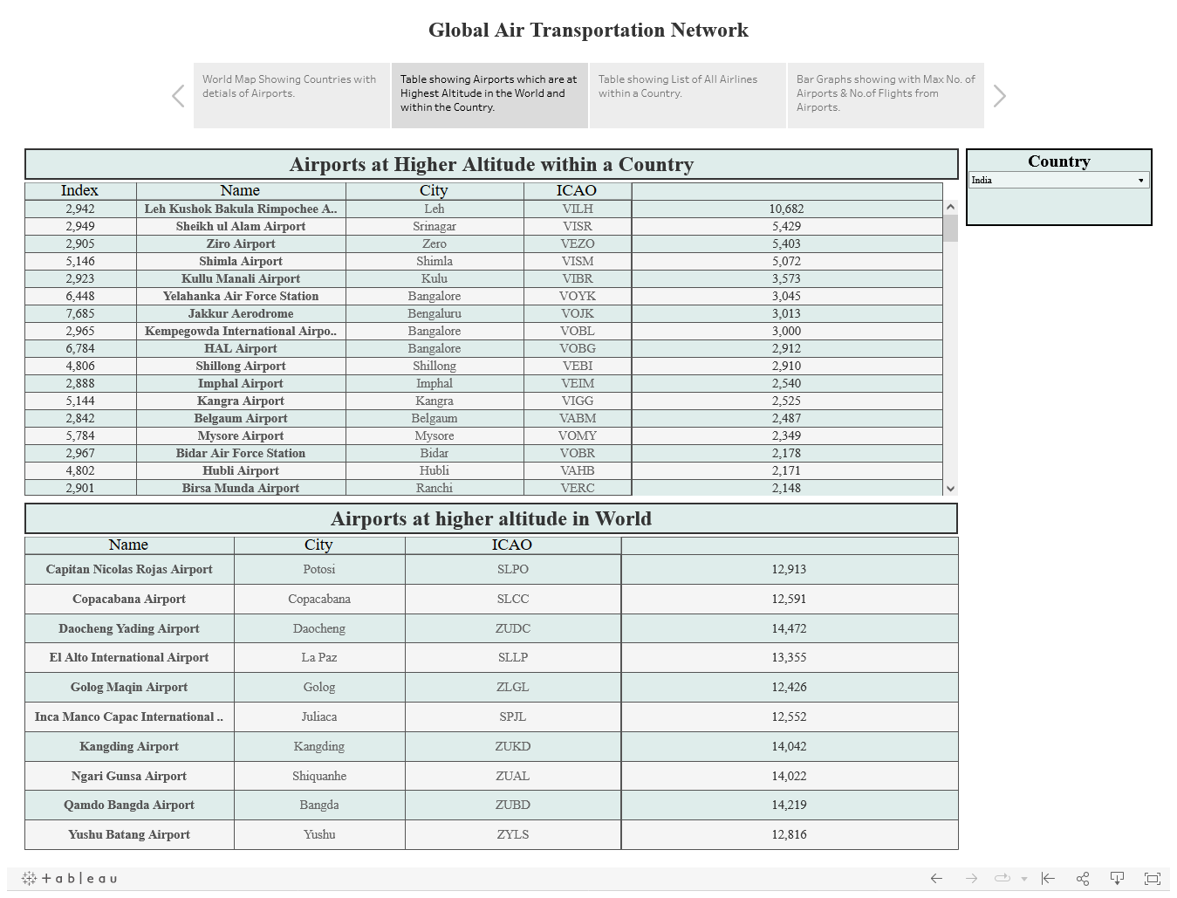

Slide 12
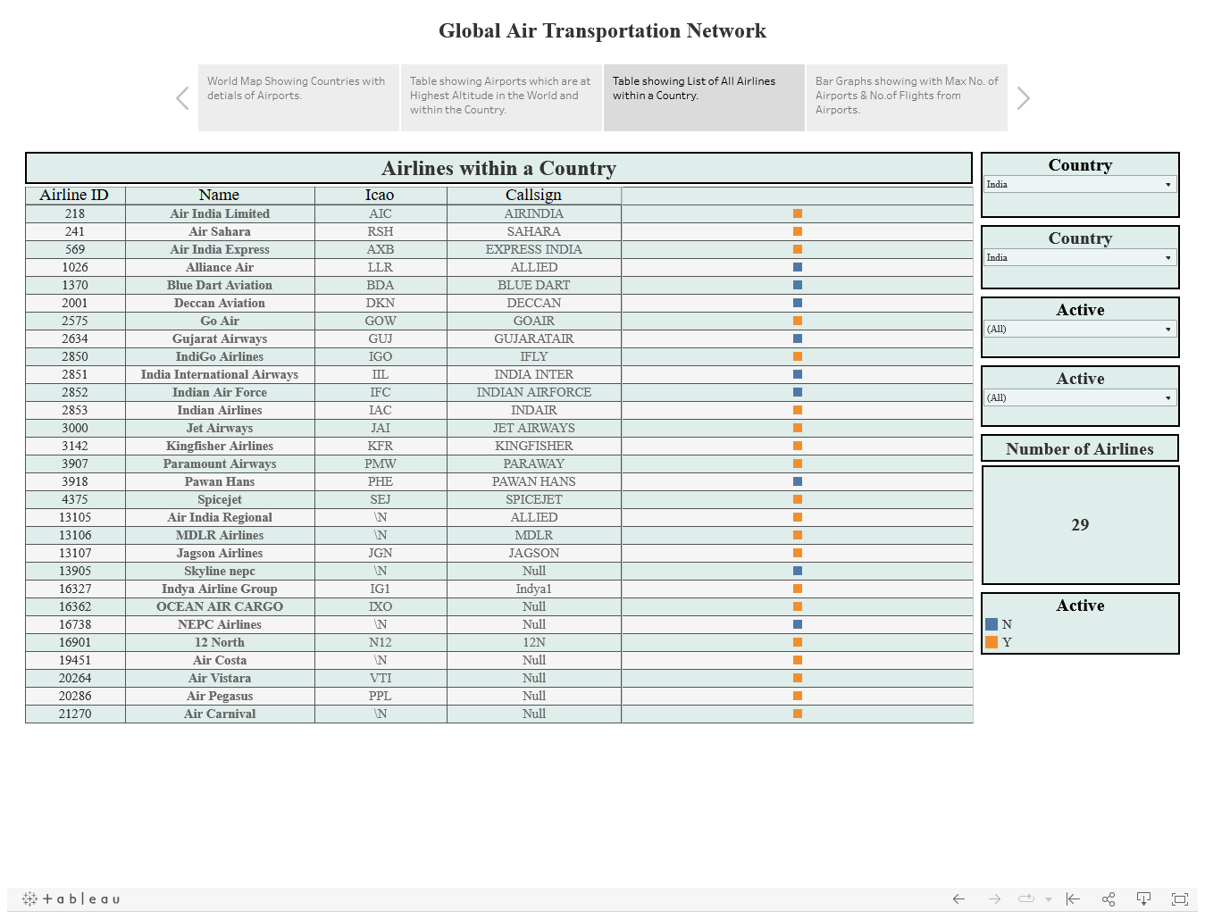

Slide 13
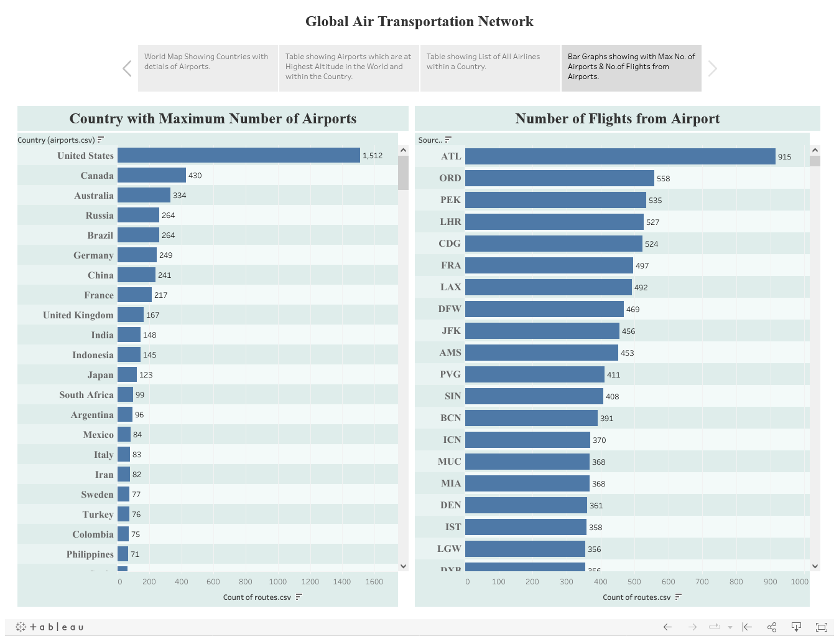

Slide 14
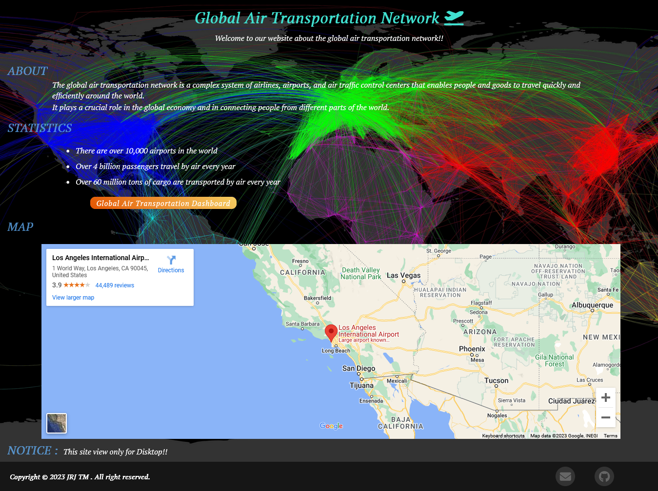

Slide 15
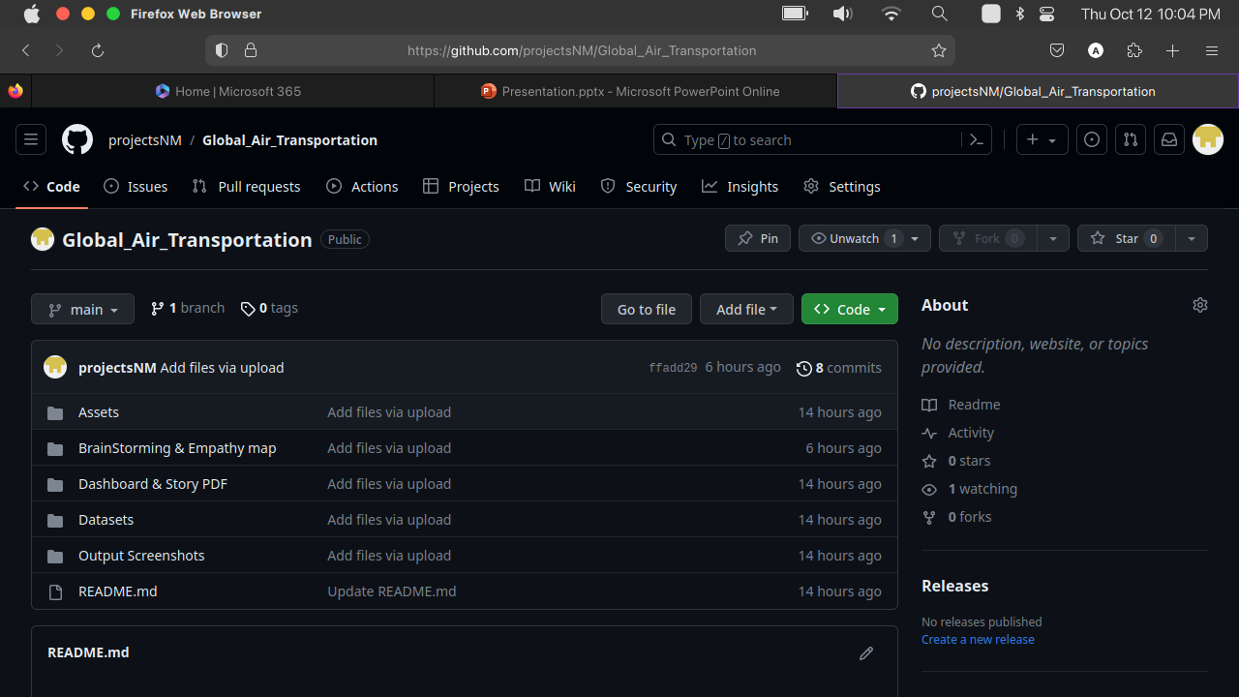
https://github.com/projectsNM/Global_Air_Transportation

Slide 16
THANK YOU

